Slide 1
The Soul of Money
Beyond Greed and Scarcity
Unpublished Manuscript
by Bernard Lietaer

Slide 2
This is an exploration of the relationship between the type of money a culture uses, and the way the culture itself behaves. It starts with a look at archetypal psychology, and the unconscious factors activated by different types of money, explores a missing archetype from modern money systems, and examines how that missing archetype was active in the High Middle Ages (builders of the cathedrals) and Dynastic Egypt. It explores different modern money types, and looks at the characteristics of the ideal type. Finally, it explores the cultural characteristics of a people who could use the ideal money system.

Slide 3
How To Experience This Material
This presentation is designed to be received thoughtfully and deliberately, at one’s own pace.
It is not effective to read this material as fast as you can, so you just get through it.
Many of the concepts presented are very different from those by which you have been living your life. Take a bit of time to consider the concepts, and how they may be true.

Slide 4
How To Experience This Material
A few of the more important or difficult concepts are presented in an animated format.
This is done so that you will be encouraged to take the necessary time to contemplate the concepts presented.
For this reason, it is strongly suggested to view this presentation in a “Slideshow” form, and not from the Powerpoint editor window.
Animated slides can appear quite confusing without the slide show player.

Slide 5
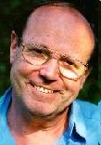
Bernard Lietaer
BS and MS in Electrical Engineering in Belgium
MBA from Mass Inst Tech
PhD in Economics from MIT
Former head of Electronic Data Dept of Belgian Central Bank
This led to his design and implementation of the ECU, which became the Euro
Designed electronic payment systems
Worked in Latin America as consultant in oil, mining, banking, etc
Visiting Professor in Archetypal Psychology, Sonoma University
Visiting Scholar at Naropa University to set up business school
Recognized as one of the top traders in the world
Author of more than 13 books
www.lietaer.com

Slide 6
A New Way To See Money
A New Way To See Society
A New Way To See Ourselves

Slide 7
How Do We See the World?
How do we organize our observations?
How do we separate ourselves from the world?
How do we integrate ourselves into the world and into our observations?
Ken Wilbur has a useful method: The Four Quadrant Map

Slide 8
Ken Wilber’s Four Quadrants Classifying Fields of Knowledge
Individual
Interior
Exterior
(Interpretation of Meaning)
(Description of Behavior)
Collective

Slide 9
Ken Wilber’s Four Quadrants Classifying Fields of Knowledge
Individual
I
It
Interior
Exterior
(Interpretation of Meaning)
(Description of Behavior)
We
Its
Collective

Slide 10
Ken Wilber’s Four Quadrants Classifying Fields of Knowledge
Individual
It is possible to experience any subject from any of the four quadrants.
By shifting one’s attention from one quadrant to another, and experiencing the subject from each viewpoint one gains a more complete understanding of the subject
I
It
Interior
Exterior
(Interpretation of Meaning)
(Description of Behavior)
We
Its
Collective

Slide 11
Ken Wilber’s Four Quadrants Classifying Fields of Knowledge
Individual
Spirituality
Physics
Individual Psychology
Biology
I
It
Empiricism
Behaviorism
Interior
Exterior
(Interpretation of Meaning)
(Description of Behavior)
Cultural History
Systems Theory
We
Its
Collective Psychology
Economics
Evolutionary Psychology
Political Economy
Social Systems
Collective

Slide 12
Ken Wilber’s Four Quadrants Classifying Fields of Knowledge
Individual
Most Books
About Money
Are In This
Quadrant
Savings
This is what
we will talk
about today
Spirituality
Physics
Individual Psychology
Biology
Investing
It
Empiricism
Earnings
The Soul of Money
Behaviorism
(not dealt with here)
Interior
Exterior
(Interpretation of Meaning)
(Description of Behavior)
(Interpretation
of Meaning)
The Future of Money
Bernard’s Book
The Future of
Money
Goes Here
Cultural History
Systems Theory
Its
Collective Psychology
Economics
Evolutionary Psychology
Political Economy
Social Systems
Collective
These are all external or behavioral experiences of money.

Slide 13
“Money is a singular thing.
It ranks with love as man’s greatest source of joy.
And with death as his greatest source of anxiety.”
John Kenneth Galbraith, Economist

Slide 14
Shadows and Archetypes
The keys to understanding
the structure of the psyche,
and the Soul of Money

Slide 15
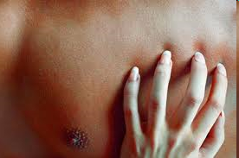
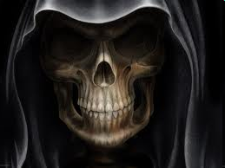
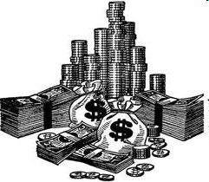
Three Taboos
Western civilization has been characterized by three foremost taboos:
  sex,
  death
  money.
For centuries, they were topics that were considered inappropriate to bring up in “polite company”.

Slide 16
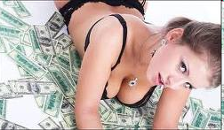
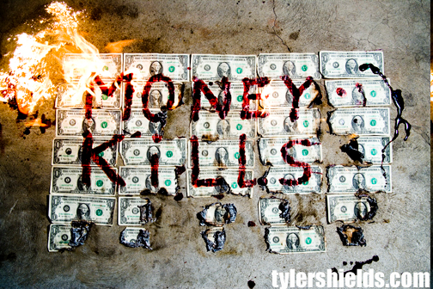
Three Taboos
The sexual revolution of the 1960s brought the first one into the open.
The AIDS epidemic of the 1980s has made us face death, combined with sex, and talk about it even with our youngsters.
We will now tackle the last taboo: money.

Slide 17
“That which we do not bring to consciousness appears in our lives as fate.” CG Jung
In societies where the feminine was not repressed, sex, death and money were not the taboo topics they have become in our modern world.
Whenever the feminine was repressed, these topics split off from consciousness.

Slide 18
Therefore, in our world, we have become “fated” to have our lives run by our emotions around these three issues.
Significantly, sex, death and money happen to be the three main attributes of one single archetype - the Great Mother - that has been the object of systematic repression for several millennia in Western history.

Slide 19
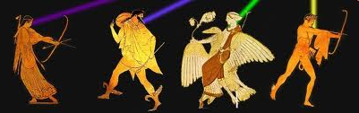
Archetype
a recurrent image that patterns human emotions and behavior, and which can be observed across time and cultures.

Slide 20
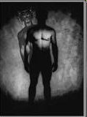
Shadow
The Shadow is the way an Archetype manifests whenever it is repressed.
The Shadow reforms the external world to match the deficit in the internal world.
The Shadow can be “the elephant in the room,” the means for the subconscious to show the conscious the way to wholeness.

Slide 21
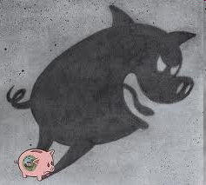
Money and the Shadow
Any society’s money system - including our own - is precisely such a way of “translating into visible reality the world within us”, i.e. of projecting on and enforcing in the physical world mostly unconscious archetypal forces.

Slide 22
What archetypes and shadows have in common is to pre-dispose people to act in certain predictable ways.
The archetype embodying the Higher Self is the Sovereign; represented by the King for men, or the Queen for women. If, for whatever reason, someone is repressing his or her Higher Self - i.e. the Sovereign within - he or she will tend to behave either as a Tyrant or as a Weakling, the two shadows of the Sovereign.
The Tyrant possesses an excess of a healthy Sovereign’s emotional and behavioral attributes, while the Weakling has a deficit of the same characteristics. There is always a direct relationship of fear between the two shadows of an Archetype. Indeed a Tyrant is primarily afraid of appearing weak, and a Weakling is afraid of appearing tyrannical.

Slide 23
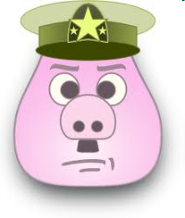
Sovereign Archetype Shadow Polarities
Furthermore, it is well known that whenever one scratches below the surface of a Tyrant, one invariably discovers a Weakling.
Conversely, whenever someone weak is given power over someone else, (s)he will often turn into a Tyrant.

Slide 24
The Shadow is what is expressed when the ego departs from the balanced Archetypal expression
Sovereign
(King / Queen)
Tyrant Weakling
Shadow fear Shadow
Balanced
Archetype
Yin
Shadow
Yang
Shadow
Yin
Shadow

Slide 25
Fear splits an archetypal energy into two polar energies
Warrior:
  Sadist and Masochist
Lover
  Addicted or Impotent
Sovereign
  Tyrant or Weakling

Slide 26
The Archetype of the Sovereign and its two Shadows (Moore and Gillette)
Sovereign
(King / Queen)
Tyrant Weakling
Shadow fear Shadow
Fear splits an archetypal energy into two polar shadow energies

Slide 27
The Ego among the Archetype of the Sovereign and its Yin-Yang Shadows
Sovereign
(King / Queen)
Tyrant Weakling
(Yang Shadow) fear (Yin Shadow)
Ego
The further that the ego is separated from the balanced archetype, the wider fear can split the two shadows.

Slide 28
Each pole represents a Yin or Yang Excess
Archetype | Yin Excess | Yang Excess
Sovereign | Weakling | Tyrant
Lover | Impotent | Addict
Magician | Dionysus (Indiscriminate) | Apollo (Hyper-rational)
Warrior | Masochist | Sadist

Slide 29
Integration of the Sovereign Archetype
Sovereign
(King / Queen)
Tyrant Weakling
(Yang Shadow) fear (Yin Shadow)
Integration
Ego
As the Ego integrates with the balanced energy of the archetype, fear is reduced, the shadows are less separated, and the shadows tend to re-integrate with the balanced archetype.

Slide 30
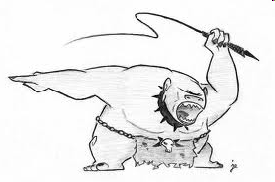
The Shadow is not the enemy
One of the paradoxes of “consciousness growth” is that the Shadow is also our taskmaster, relentlessly needling us to evolve toward our next evolutionary stage

Slide 31
Map of the Human Psyche
Based on Carl Jung’s quaternio of archetypes

Slide 32
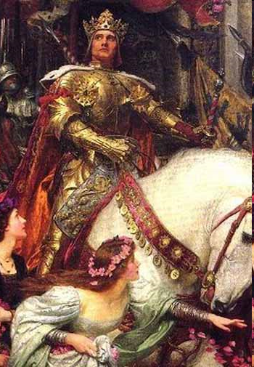
The Sovereign
The Sovereign is the integrating force at the core of the psyche.
This archetype represents the Higher Self, which (when healthy) mobilizes, accepts, and integrates the forces of all the other archetypes.
In turn it makes the necessary sacrifices (from sacer facere literally “making sacred”) for the good of the whole.
It is androgynous (both male and female, integrating the energies of both the King and the Queen).
Its two shadows are the Tyrant and the Weakling.

Slide 33
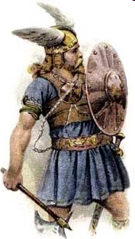
The Warrior
The Warrior masters discipline, asceticism and force.
The Warrior protects what needs protecting, expands for the common good, and destroys what needs to be eliminated to enable the blossoming of new life and forms.
The ideal of the Western Medieval knight and the Samurai in the Japanese tradition embody this archetype. Its original usefulness came from hunting and/or avoiding being hunted by animals of prey.
Its two shadows are respectively the Sadist (Yang shadow) and the Masochist (Yin shadow).

Slide 34
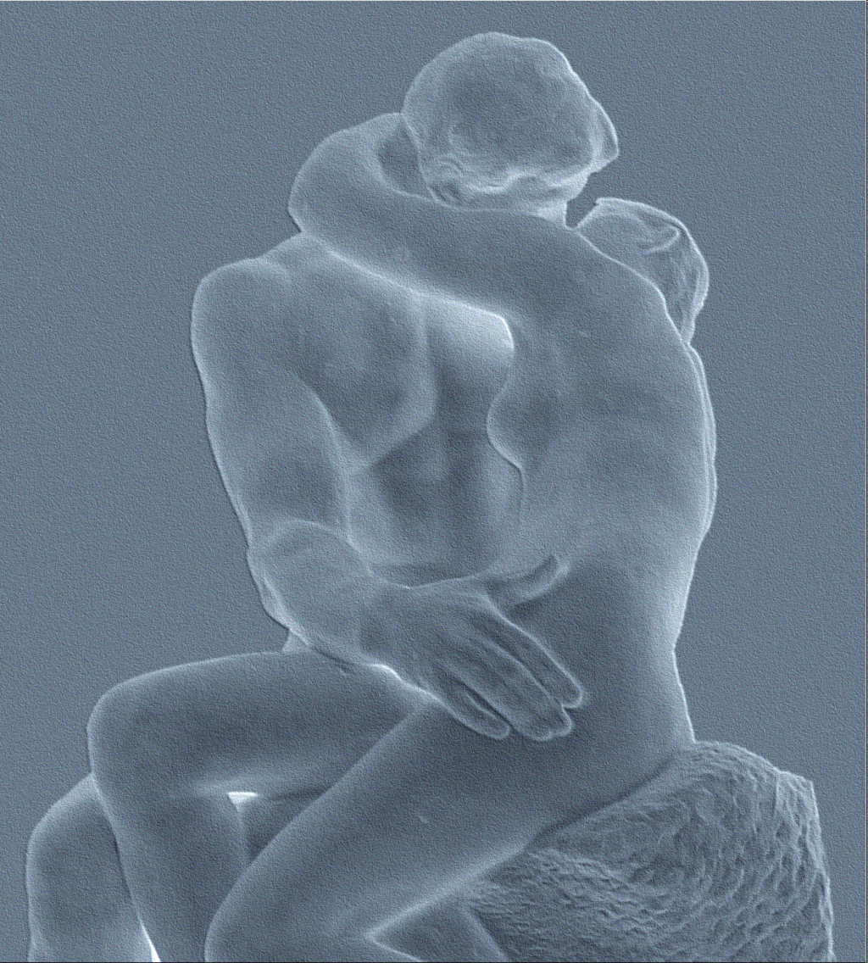
The Lover
The Lover masters play and display, sensuous pleasure without guilt.
It is the power of empathy and connectedness to other people and everything else.
The Lover is particularly sensitive to art and beauty.
Its two shadows are respectively the Addicted Lover (Yang shadow) and the Impotent Lover (Yin shadow). Addictions have become one of the most universal features of Modern society.

Slide 35
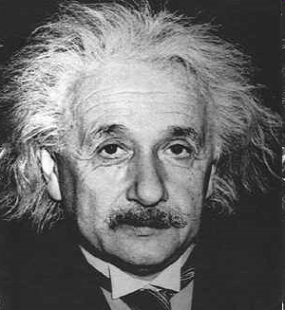
The Magician
The Magician masters knowledge and technology in the material world (through crafts, science, technologies) as well as in the immaterial worlds (shaman, healer, priest or priestess) or the connections between both (alchemist, Magus).
Its two shadows are respectively the hyper-rationalist Apollonian know-it-all on the Yang side and the indiscriminate Dionysian energy on the Yin side.

Slide 36
But Is This Map Complete?
Based on Carl Jung’s quaternio of archetypes

Slide 37
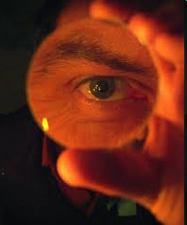
The Case of the Missing Archetype
“The Tao is called Great Mother:
Empty yet inexhaustible,
It gives birth to infinite worlds.”
Lao Tzu
“For a civilization, history is the unconscious.”
Richard Tarnas

Slide 38
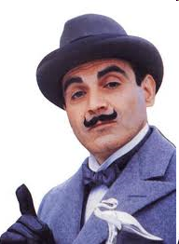
Question: How would Inspector Poirot discover that an important archetype is missing in the archetypal map?
A hint: If an archetype is deeply repressed in a society, it will not show up in its dominant mythologies.
The answer is that:
A repressed archetype would reveal itself by big “fingerprint” shadows in a society;
One would know that two shadows belong to the same archetype when they are in Yin-Yang polarity and strongly linked by fear;
And finally, these shadows would be considered as “normal” human behavior and feelings.

Slide 39
The Great Mother (Provider) Archetype and her shadows

Slide 40
These two shadows fit indeed all three of our detective’s criteria
1. Greed and the fear of scarcity are quite prevalent in our societies, and have been for extensive periods of time.
2. As mentioned in the previous chapter, these two shadows form a Yin-Yang polarity, and are linked by fear.
3. They are considered “normal,” in fact so normal that Adam Smith felt the need to develop a whole theory, called economics, whose purpose is to allocate scarce resources through the means of the individual desire to accumulate.

Slide 41

What is the evidence that this is the missing archetype?
That the Great Mother archetype was present and active when money was invented;
That there is evidence of an important direct connection - beyond the coincidence of time periods - between money systems and the Great Mother archetype;
That the Great Mother archetype was later repressed and that this affected the money system.

Slide 42

The Great Mother
“The Goddess in all her manifestations was the symbol of unity of all life in Nature. Her power was in water and stone, in tomb and cave, in animals and birds, snakes and fish, hills, trees and flowers. Hence the holistic and mythopoetic perception of the sacredness and mystery of all there is on Earth.”
The Great Goddess embodied in fact the entire archetypal map. She was Queen, Warrior, Lover, Magician and Great Mother.

Slide 43
The Great Mother Archetype and Early Money Systems

Slide 44
The Great Mother Archetype and Early Money Systems
WHAT IS MONEY?
  Money is not a thing, although it may appear to be an incredible variety of things.
  For our purposes here, money is defined as an agreement within a community to use something as a means of payment.
  Means of payment may be different that means of exchange.

Slide 45
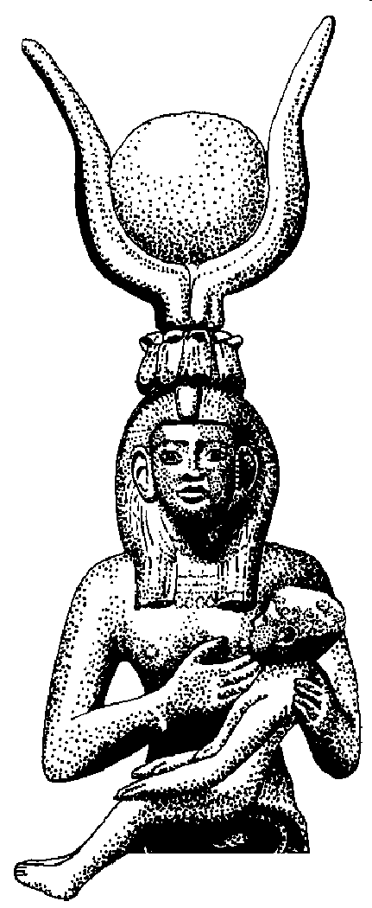
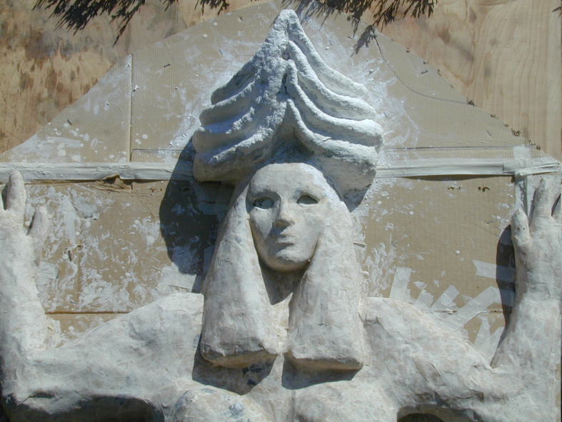
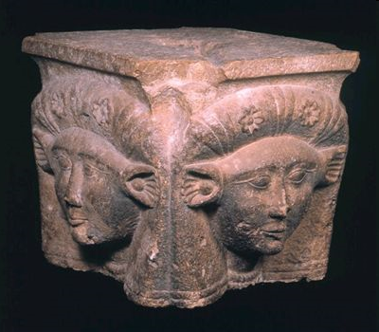
Cattle was one of first forms of money. And cattle were linked to the Great Mother.
Hathor
Ishtar/Inanna
Notice the horns!
Isis

Slide 46
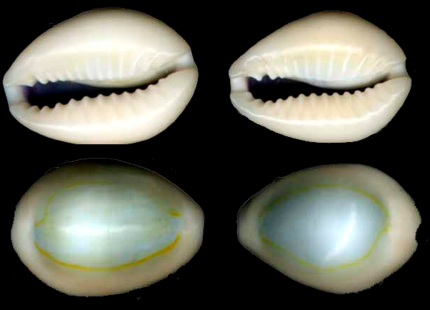
The cowrie, representing the vulva, is another widespread form of money associated with the Goddess.

Slide 47
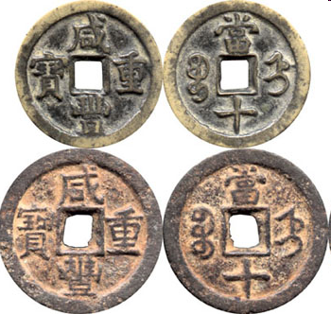
Chinese Cash
While the circle is the Yang symbol of heaven, the square represents the Yin element of Earth in the Taoist symbolic system. Here again the implied meaning refers to Mother Earth’s fertility at the core of money

Slide 48
Loss of the Great Mother
The Invasions of Swords, Horses, and Patriarchy

Slide 49
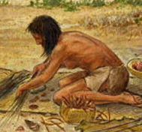
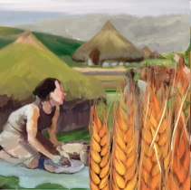
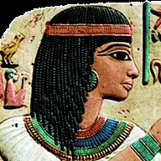
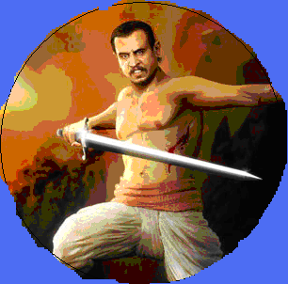
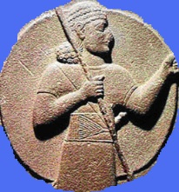
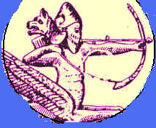
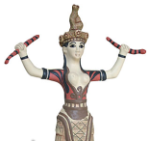
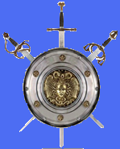
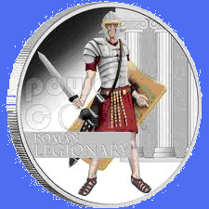
Civilization Strands Leading to the Western Mindset
Paleolithic
(Matriarchal)
Neolithic
Neolithic
“Garden Cultures”
Nomadic Herder Cultures
(initially Matrifocal)
(Patriarchal)
Canaanite
Mesopotamian
Egypt
Indo-European
Semitic
(Sumerian)
Cretan
(Minoan)
Classical Mediterranean
Yang or Patriarchal
Yin or Matrifocal
(Greek/Roman)
Islam
Western

Slide 50
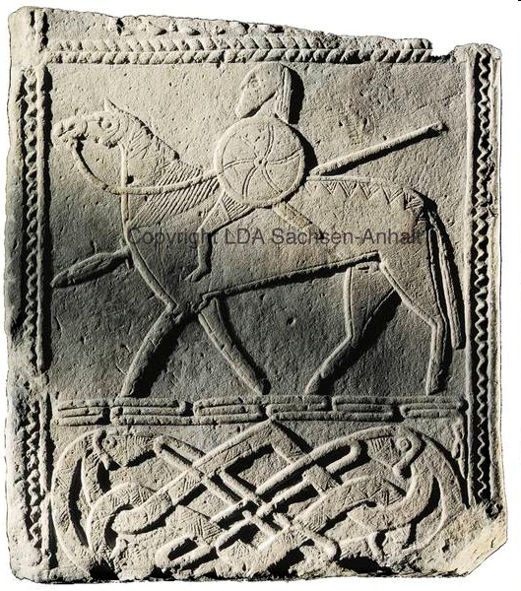
Indo-European Invasions
Old Europe (c. 40,000 to 5,000 years ago) was primarily “matrifocal, sedentary, peaceful, art-loving, and earth-and-sea bound”.
This civilization was overthrown around 3500 BC by a “patrifocal, mobile, warlike, ideologically sky-oriented society, indifferent to art”
The myth of Wotan, the Germanic God of war, incarnates the early horsemen, who were the specialized cast of warriors among the Indo-Europeans. (Wotan, Stela of Hornhausen, Halle Museum)

Slide 51
The Change to Patriarchy
“The establishment of patriarchy was not an event, but a process developing over a period of nearly 2,500 years, from roughly 3,100 B.C. to 600 B.C. It occurred, even in the Ancient Middle East, at a different pace and at different times in several distinct societies.”
”The appropriation by men of women’s sexual and reproductive capacity occurred prior to the formation of private property and class society. Its commodification lies, in fact, at the foundation of private property.”
Lerner, Gerda The Origins of Patriarchy (New York and Oxford: Oxford University Press, 1986) pg 8.

Slide 52
The Change to Patriarchy
“The archaic states were organized in the form of patriarchy; thus from its inception, the state had an essential interest in the maintenance of patriarchal family.... Thus women’s subordination was institutionalized in the earliest laws and enforced by the full power of the state. ... The dethroning of the powerful Goddesses and their replacement by a dominant male God occurred in most Near Eastern societies following the establishment of a strong and imperialistic kingship.”
Lerner, Gerda The Origins of Patriarchy (New York and Oxford: Oxford University Press, 1986) pg 8.

Slide 53
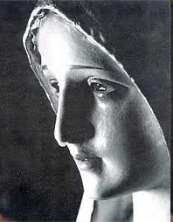
The Great Mother archetype was hidden
In Greek, Roman, and Christian mythology, the Mother as fecund source of all was replaced by the strict virgin—Athena, Artemis, Mary.
Yet, the Great Mother myth continued to emerge as the Black Madonna

Slide 54
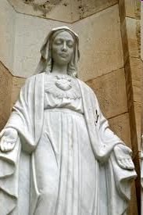
Cult of Mary—the Goddess Peeks
The Cult of Mary reached its peak in the Central Middle Ages (9th – 12th Century)
In France alone, in just one century (from 1170 to 1270), over 100 churches and 80 cathedrals were built for Her!
In contrast, not a single one was dedicated to Christ, astounding in a religion that is supposed to be all about Him!

Slide 55
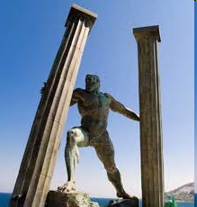
The Male Hero
The male hero emerged in patriarchal cultures as the shaping force for the male.
The Samurai and Crusading Knight, Don Quixote and Superman represented the warrior archetype
The Missionary, the Prophet, and Dante embody the Magician.
King Arthur and others reveal the King.
The Hero archetype subjugates the Mother.

Slide 56
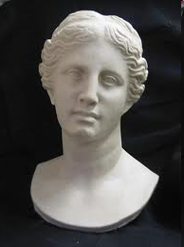
Pockets of Historical Survival of the Great Mother cults
Areas where the Invader did not arrive until much later, such as the Great Mother cults in Malta, Crete, Britain.
Eleusian mysteries and Diana cults were active in Greece until 4th Century.
Isis Cult was alive in Egypt until 2nd Century AD
The Black Madonna Cults in Europe from the 10th to the 13th century all over Christian Europe.

Slide 57
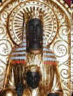
The Black Madonna
More than 500 images represented this enigmatic figure, whose face and hands are pitch-black.
Many of the cathedrals that spread all over France had been built for Black Madonnas, including Chartres, Reims, Rocamadour, St Michael’s Mount, Dijon, Orcival, Vichy, Poitiers, Le Puy, Beaune- a total of 302 sanctuaries in France alone!

Slide 58
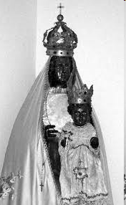
The Black Madonna
The Black Madonna Cult was associated with:
  Gnosis, Alchemy, and Hidden Knowledge
  Mary Magdalene
  Feminine Power
  Troubadours/Minnesingers/Love Poetry
  Opposition to Centralized Power
  The remnants of Pagan cults
  Hidden Pagan Sites, ie, Chartre
  Templars, Cathars, Albigensians
  The Grail Legends

Slide 59
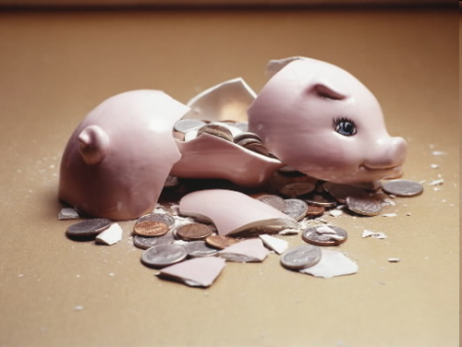
Monetary Consequences of the Repression of the Great Mother Archetype
Fear of Scarcity and Greed are considered “Normal” for “civilized societies”
The money system rewards those who accumulate money, and punishes those who don’t play the game.

Slide 60
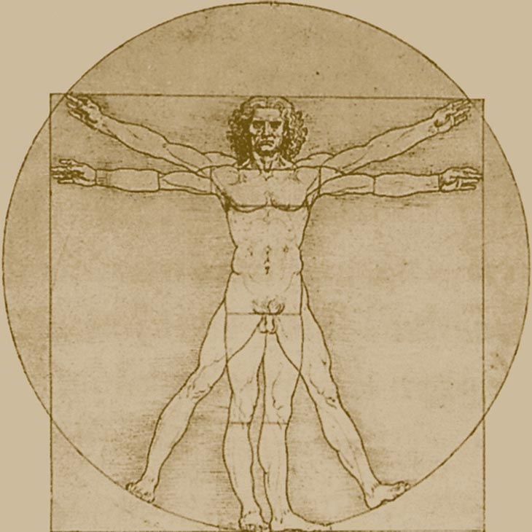
The Archetypal Human
Sovereign King/Queen
Warrior
Lover
Great Mother (Provider)
Magician (Priest/Scientist

Slide 61

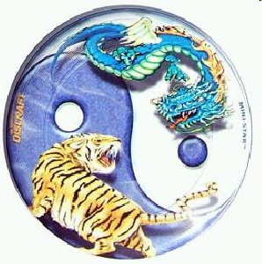
Yin/Yang Coherence
“When male and female combine,
all things achieve harmony.”
Lao Tzu

Slide 62
Yin-Yang Coherences
Yang Coherence | Yin Coherence
Competition | Cooperation
Hording, Accumulating, Concentrating | Circulating, Giving, Connecting
Goal Setting, Performance, Growth | Caring, Quality of Live (Not Quantity)
Having, Doing | Being
Peak Experience | Endurance, Sustainability
Rational, Analytical | Intuition, Empathy, Synthesis
Logic, Mental, Linear | Paradox, Physical-Emotional, Non-Linear
Pursuit of Certainty | Ability to hold Ambivalence
Technology Dominates | Interpersonal Skills Dominate
Bigger is Better; Expansion | Small is Beautiful; Conservation
Independence | Interdependence
Hierarchy works best | Egalitarian Works Best
Central Authority | Mutual Trust
Planning, Control of Future | Self-Organizing “Chaos”, Faith in Future
Cause and Effect | Synchronicity
Parts Explain Whole. Reductionism | Whole Explains Parts. Wholism

Slide 63
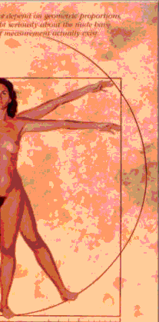
Archetypal Human and its Yin, Yang and Integrative Functions
Integrative
Sovereign (King/Queen)
Feminine/Yin
Masculine/Yang
Warrior
Lover
Great Mother/ Provider
Magician (Priest/Scientist)

Slide 64
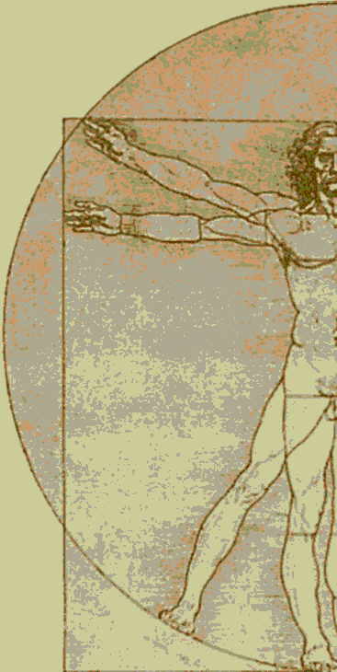
Archetypal Human and Relationships to Others and the Universe
Integration – Relating to Self
Sovereign (King/Queen)
Relating to Others
Warrior
Lover
Relating to Universe/ Material World
Magician (Priest/Scientist)
Great Mother/ Provider

Slide 65
The Archetypal Human and its Ten Shadows
Tyrant
Tyrant
Tyrant
Tyrant
Tyrant
Tyrant
Tyrant
Tyrant
Tyrant
Tyrant
Tyrant
Tyrant
Tyrant
Tyrant
Weakling
Weakling
Weakling
Weakling
Weakling
Weakling
Weakling
Weakling
Weakling
Weakling
Weakling
Weakling
Weakling
Weakling
Weakling
Weakling
Weakling
Weakling
Weakling
Weakling
Weakling
Weakling
Sovereign (King/Queen)
Sovereign (King/Queen)
Sovereign (King/Queen)
Sovereign (King/Queen)
Sovereign (King/Queen)
Sovereign (King/Queen)
Sovereign (King/Queen)
Sovereign (King/Queen)
Sovereign (King/Queen)
Sovereign (King/Queen)
Sovereign (King/Queen)
Sadist
Sadist
Sadist
Sadist
Sadist
Sadist
Sadist
Sadist
Sadist
Addict
Addict
Warrior
Warrior
Warrior
Warrior
Lover
Lover
Lover
Lover
Lover
Lover
Lover
Lover
Lover
Lover
Lover
Lover
Masochist
Masochist
Masochist
Masochist
Masochist
Masochist
Masochist
Masochist
Masochist
Masochist
Masochist
Masochist
Masochist
Masochist
Impotent
Impotent
Impotent
Impotent
Impotent
Hyper-Rational
Hyper-Rational
Hyper-Rational
Hyper-Rational
Hyper-Rational
Hyper-Rational
Hyper-Rational
Greed
Greed
Greed
Greed
Magician (Priest/Scientist)
Magician (Priest/Scientist)
Magician (Priest/Scientist)
Magician (Priest/Scientist)
Magician (Priest/Scientist)
Magician (Priest/Scientist)
Great Mother/ Provider
Great Mother/ Provider
Great Mother/ Provider
Great Mother/ Provider
Great Mother/ Provider
Great Mother/ Provider
Great Mother/ Provider
Indiscriminant
Indiscriminant
Indiscriminant
Indiscriminant
Indiscriminant
Indiscriminant
Indiscriminant
Indiscriminant
Indiscriminant
Indiscriminant
Fear of Scarcity
Fear of Scarcity
Fear of Scarcity
Fear of Scarcity
Fear of Scarcity
Fear of Scarcity

Slide 66
Shadow Resonance-Yang
Tyrant
Sovereign (King/Queen)
Sadist
Addict
Warrior
Lover
Hyper-Rational
Greed
Magician (Priest/Scientist)
Great Mother/ Provider
As more Yang shadows are expressed, all archetypes tend to be pulled to the yang side.

Slide 67
Shadow Resonance-Yin
As more Yin shadows are expressed, all archetypes tend to be pulled to the yin side.
Weakling
Sovereign (King/Queen)
Warrior
Lover
Masochist
Impotent
Magician (Priest/Scientist)
Great Mother/ Provider
Indiscriminant
Fear of Scarcity

Slide 68
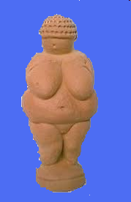
Conclusions of the Missing Archetype
Money has been associated since prehistoric times with the Great Mother.
As “modern” cultures suppressed the Great Mother archetype, they have created cultures that express the shadows of the missing archetype.
Greed and fear of scarcity are not “natural” human characteristics, but the shadow expressions of the missing Great Mother archetype.
Three taboos of modern society—sex, death and money--tend to occur together, as they are the shadows of the missing archetype.
Money has been associated since prehistoric times with the Great Mother.

Slide 69
Characteristics of Money
Yin Money
And
Yang Money

Slide 70
Functions of Money
Economists generally agree on three functions of money:
  A medium of exchange:
  Money is defined as an agreement within a community to use something as a means of payment.
  A store of value
  A unit of account—the unit of measurement of value/cost of goods, services, or assets.

Slide 71
All of Our Money is Yang Money
As we will see later, all of the national money in use in the world is classified as “Fiat Currency”.
  That means that it only has value because an authority said that it has value
We generally know about Yang money already
We will examine the characteristics of Yang money types, and then we will contrast Yin money types, and the cultures which used them.

Slide 72
Characteristics of Money in Yang Cultures
Precious and Scarce
Store of Value
Monopoly of currency
Hard Metal
“Long Distance Money”
Earns Interest
Concentrated by relatively small elite group

Slide 73
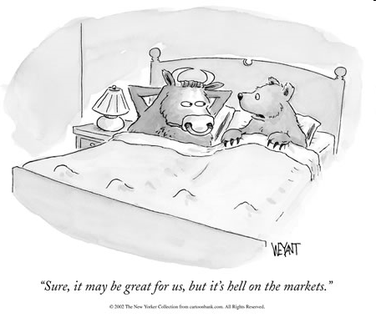
Boom and Bust Cycles are Characteristics of the Magician
Hard money is subject to cycles of prosperity and depression
Parallels the instability of the Magician archetype:
  Dionysus or Bacchus with wild indiscriminate spending
  Apollonian rigid scientific control of the economy
There is no way to avoid these cycles with a Yang-only currency system.

Slide 74
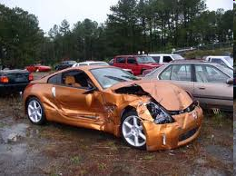
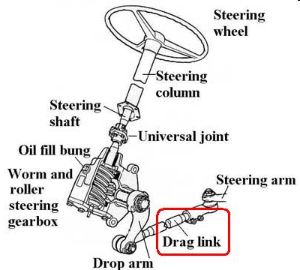
Car Metaphor
Most economists today believe that the irregularities in the economy are a result of inadequate knowledge and control of the economy.
Bernard Lietaer says instability is inherent in our economy. He compares this with a car with a bad steering mechanism: No matter how careful a driver you are, if you drive this car in the mountains, you are going to crash.

Slide 75
Two Case Studies of Yin Currencies
High Middle Ages (10th to 13th Centuries) in Northern Europe
Dynastic Egypt

Slide 76
Benefits of Yin Currencies
Whenever such local Yin currencies complement the dominant Yang currency they have the four following effects:
  They were the unsung heroes of remarkable economic well-being for the ordinary population
  They spontaneously induced investment patterns with unusually long-term perspectives
  They have characteristically appeared in societies only when the feminine archetype was honored, an admittedly rare occurrence in Western history
  They were the precursors of a contemporary local currency movement that could become a key tool to make possible Sustainable Abundance in our own lifetimes.

Slide 77
Characteristics of Money in Yin Cultures
Abundant
Means of Exchange, but Not a Store of Value
Usually co-exists with a Yang currency
More Ordinary materials
No interest: Demurrage
Frequently collected and re-issued
Abundant throughout the culture

Slide 78
Characteristics of Yin Currency Societies
Greater food supply and health
  English population did not have such stature until Victorian Age
Not as much time spent on work
More time and energy spent on creativity:
  Love Poems
Less resources spent on military

Slide 79
Characteristics of Yin Currency Societies
Greater Female Power
  Land Ownership
  Occupations Open to Women
More open sexuality
Less Sexualization of Female Body and Breasts
Black Madonna/Great Mother Cult Present

Slide 80
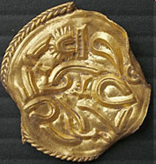
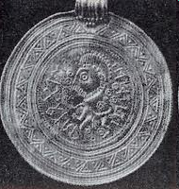
Bracteaten as Money
Used in High Middle Ages in Europe (9th – 12th Centuries)
From Latin: Bractea = thin plate
Thin metal wafer embossed on one side
Frequently recollected and re-issued at a cost, so not used as a store of wealth

Slide 81
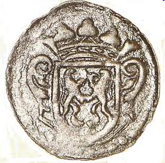
Bracteaten
Their circulation was limited not only geographically but temporally
Edges frequently torn off to pay debts
Recoinage became annual event: anyone wishing to trade at the annual fair needed to exchange the new money

Slide 82
Medieval Demurrage
Renovatio Monetae: Coins recollected every few years, and only 3 coins issued for every four received
  Equivalent to 25% Tax
  About 0.35% per month
  Did not adversely affect economy
Later kings recollected and reissued coins more than once per year
Still later (12th Century), coins were debased, ie, gold or silver content was decreased
  This led to economic and societal decline

Slide 83
Demurrage vs Interest
Interest pays money for the use of money.
The problem is that when money is created, there is never enough money created to pay the interest.
Thus, interest removes value from the economy as a whole, in order to pay the banks or holders of money.
Interest thus acts as a tax on all money, which is sent to the ultimate interest collectors, the wealthy.
Thus, in a yang money system, money gravitates toward the wealthy

Slide 84
Demurrage vs Interest
In a Yang money system, the people are taught:
SAVE MONEY for a rainy day.
This is scarcity mentality, caused by the absence of the Great Mother archetype being active in our society.
But, we assume it is the only way to think!

Slide 85
Demurrage vs Interest
Yang money transactions reward individuals, but not society nor the community.
Those who work hardest FOR THEMSELVES are rewarded WITH INTEREST by a Yang money system.
Think of those who play the Yang Money, Saving Money game the best:
  Horders. Mizers. Stock Brokers.
  They have the biggest bank accounts.
  But they have no friends.

Slide 86
Demurrage vs Interest
Yang money systems, or in other words, Interest systems, reward the individual, but not the community.
Yang money systems, Interest systems, reward short term investments. That is how they teach us to think.
For the benefit of the world, a new way of thinking might be helpful.

Slide 87
Demurrage vs Interest
Demurrage is reverse interest, a charge on using or storing money.
Demurrage manifested as the bracteaten were collected every three years.
  Four coins were collected, but only three reissued.
  This is effectively a loss of 25% in 3 years, or about a 10% yearly or 0.35% monthly tax on the use of the money.
Demurrage therefore can be considered as a tax which tends to decrease the value of money.

Slide 88
Demurrage vs Interest
If there is a “tax” on money, then there will be a natural tendency to get rid of it, instead of storing or hording it. Call it the Hot Potato Effect.
The Hot Potato Effect makes the money circulate much faster than typical Yang-type Money, which tends to be saved in banks or under mattresses.
Circulating money faster means more wealth in the community, and therefore, more prosperity.

Slide 89
Demurrage vs Interest
If the value of money is tending to decrease, then since it takes more money to buy things, the value of material goods will tend to increase.
Thus, demurrage decreases the value of money, but increases the value of material wealth.
In bond markets, demurrage reduces discount rates, and thus increases the present value of a long-term investment.
Demurrage encourages investment into long-term projects, instead of hording wealth

Slide 90
Demurrage vs Interest
In a society using Yin-type money with demurrage, every transaction benefits the community, as well as the individual.
Yin money also reinforces relationships, so it strengthens the community.
Yin-type money with demurrage reinforces investment into long-term investments, investments into production capabilities and systems.

Slide 91
Demurrage: Engine of Economy?
In a yin money economy, it does not make sense to save in the form of currency
Instead, savings occurs in the form of tangible, productive goods, which last a long time
For example, in the Royal Monastery of St. Denis, for the years 1229-1280, every year a significant part of the mills, ovens, wine-presses and other heavy equipment are improved upon or even completely rebuilt.
At least 10% of gross revenue (not profits) was reinvested into equipment maintenance

Slide 92

Effects of Yin Money on the Populace
No difference in diet “between village and castle”
Laborers admonished to cut down to only 4 courses per meal!
Peasants, the lowest class, had silver buttons and buckles on their clothing and shoes
Laborers worked only 6 hours per day
Average journeyman worked no more than 4 days per week, with 170 days off per year!

Slide 93
Average Height of Londoners
173 cm—Average height of 10th-12th Century Man
163 cm—Average height of 10th-12th Century Woman

Slide 94

Effect on Women’s Status
Women were much more free than in the periods before or after 10-12th Centuries
Of 312 listed professions, women were allowed to work in 108, including shop keepers, innkeepers, town guards, keeper of the Keys, etc.
Women had monopolies on certain forms of work, such as fine textiles, dairy products, dyeing, and cooking

Slide 95

Effect on Women’s Status
Women were allowed to work without regard to marital status.
Women lived longer than men (as opposed to before or after that period)
Women could own and inherit property
Women could leave a marriage at will, and if she took the children, she took half of the land
Women were involved in the arts, and even were courtly troubadours

Slide 96

An Investment in Forever
During the High Middle Ages, cathedrals began to be built throughout the region
Almost all of the 300 odd cathedrals built were dedicated to Mary, and none to Jesus Christ
In addition, 2000 abbeys were built, many were the size of towns, and 350,000 churches.
More stone was quarried in France in this period than in all of Egypt.
There was one church or cathedral for every 200 Christians; 1 per 100 inhabitants of Italy and Hungary.

Slide 97
End of the Age
The disappearance of demurrage-charged currencies occurred concurrently with the fall of the cults of the Black Virgins and Isis in their respective cultures, and with a massive drop in the standard of living of ordinary people.
Remember that such a correlation is a direct application of the general finding of archetypal psychology: archetypal figures provide valid descriptions of collective psychic sequences, and thereby can significantly shape external reality.

Slide 98

How The Music Stopped
In 1277 the Church outlawed Courtly Love.
Poets were excommunicated
Black Madonnas were replaced with white virgins

Slide 99

How The Music Stopped
Women’s roles gradually declined
  Previously able to be poets, heads of guilds or medical doctors, women now were despised as demonic temptresses, and relegated to chattel in marriage.
  Education for women was stopped—even nuns could no longer teach
Women’s bodies became sexualized; nudity became taboo

Slide 100

Three Shadows of the Great Mother Archetype
An interest in the macabre emerged, as witnessed in the art in Paris cemeteries
Thus, the three shadows of the repressed Great Mother Archetype re-emerged:
  Sex
  Death
  Money

Slide 101
How The Music Stopped
Population contracted beginning in 1300.
Land under cultivation decreased
Ability to feed the population declined
Famines first killed off 10% of the population in 1315 and 1316
Resulting epidemics then killed of 30%

Slide 102

How The Music Stopped
Inquisition was initiated to retrench the power of the Church
10-15% of the population were killed as witches
The Black Death was a result, not a cause, of the collapse of society

Slide 103
Population Decline

Slide 104
What Caused the Collapse?
The demurrage system was abused
The monetary system was contracted by increased central authority
  Larger regions made recoining more unwieldy
  Currency debasement (like Philip IV of France from 1298 onwards) affected larger areas
Royal monetary authority was enforced militarily
Destruction of Templars as Central Bankers in 1307

Slide 105

Demurrage Abused
Frequency of recoining increased
Some kings recoined four times in one year
One duke recoined 86 times in his 18 year reign

Slide 106
Centralized Authority
By the end of the 13th century, the French kingdom had grown so much in size that it had become impractical to recall the currency.
The stronger the kingdom, the less practical it becomes to keep the demurrage system going
Patriarchal power increased, with repression of women
Gold currency had been around for centuries, but it had been rarely used in local economies
  Now, since they had a monopoly, gold and silver coins tended to be horded and not circulated like the bracteanen

Slide 107

Centralized Authority
Kiss of death was the debasement of the currency by Philip IV in 1298 and onward
Philip was heavily in debt to the Templars because of wars.

Slide 108

Centralized Authority
Since debasing the currency did not help Philip’s financial position, he decided to steal the Templar treasury.
He poisoned two popes until he got one who would go along with his scheme and seize the Templars simultaneously
Still, the treasure had disappeared, along with most of the Templars
The European economy was collapsed for centuries afterwards

Slide 109
How Money Scarcity Was Created
The disappearance of demurrage created money scarcity in two cumulative ways:
  it reduced the speed with which the money circulated
  and it concentrated wealth in the cities and in the hands of the elite
The concentration of wealth at the top of the social echelon - royalty, nobility - gradually increased the flamboyance of their life styles.
Concentration of wealth eventually made the 15th-16th century Renaissance possible.

Slide 110

How it appeared to the People
Abundant Money of exchange was gone suddenly
Golden Age was over
Scarcity of Money continues to today
Ghetto vs Suburb

Slide 111

Dynastic Egypt

Slide 112

Joseph in Egypt
Surely an advanced society such as Egypt would already know how to store grain after 2000 years of civilization!
Importance of Joseph’s idea may have been the monetary system, not the simple storage of grain.

Slide 113

Ostraca as Money
Dynastic Egypt
Invented by Joseph bin Israel?
Ordinary potsherd inscribed with account information
Subject to demurrage

Slide 114

Ostraca as Money
An example of an “ostracon”, for example a shard of pottery from13th century BC Egypt, with a hieroglyphic inscription that made it a receipt for the delivery of a number of jars of wine at a specific place and time.
Such receipts for wine, corn or other storable food were used as the most common currency for at least 16 centuries in Egypt.
The redemption value of these receipts would “age”, i.e. drop slowly over time to reflect the cost of storage of the commodity involved.
For this reason, as in the Central Middle Ages with “bracteaten”, people would not tend to hoard such currencies, but they would use them as a pure medium of exchange.

Slide 115

Egyptian Demurrage
Accept 10 bags of wheat, get an ostracon receipt
A year later, may only get 9 bags back
10th bag is storage fee, or demurrage
Pays for guards, loss due to rats, etc
More sophisticated than bracteaten demurrage

Slide 116

Egyptian Economy
Greeks made fun of their ostracon economy
Egyptians thought that Greek passion for gold and silver coins was silly.
Egyptians cut Greek coins open to validate their metal content—they had no need for fancy coins
Diet was varied and abundant. Egypt was the breadbasket of the ancient world.
Egypt gave grain away as foreign aid, such as to Athens during a famine in 445 BC

Slide 117

Egyptian Economy
Work days were 8 hours long
Out of 50 days, only 18 days were work days for the whole crew.
Infrastructure, such as irrigation system, was the envy of the world
When something was built, it was built to last.
These are characteristics of the demurrage system.

Slide 118

Role of Feminine Archetype
Did any of this prosperity have anything to do with honoring the archetypal feminine?
  What was the role of the feminine archetype in Egypt, compared to other societies?
  Did this have any effect on the status of Women?
  How and why did this prosperity end?

Slide 119

Egyptian Culture
We generally think of Egyptian society as just another patriarchal system, with a male pharoah at the top.
However, it was actually, predominantly and explicitly matrifocal.
Isis was the center of the society, worshiped for over 3000 years

Slide 120

Isis as the Great Mother
There was a strong and persistent connection between Isis and the concept of Abundance.
Temples of Isis were seen as vital to the prosperity of the society.
Egyptians were seen by their contemporaries as enjoying life fully, without guilt.
Even the peculiar relationship with death was seen as a way to continue “the good life”.

Slide 121

Status of Women in Egypt
Egypt was the best place to be born a woman during the Dynastic Age from 3000 to 322 BC.
Egyptian women had legal, social and sexual independence unequalled in Greece, Rome, or even Europe until the 19th Century.
Egyptians were the first people to write love poetry.
Women often took the initiative in romance, to the amazement of foreign visitors!

Slide 122

Status of Women in Marriage
Marriage in Egypt was an entirely private affair, in which the state took no part or interest and kept no record.
Women could marry whomever they wanted, regardless of class, even slaves and foreigners.
Detailed marriage contracts replaced customs.
Sons and daughters could inherit from either parent.
Women had preference for custody of children.
Women probably had a higher status than men in marriage.

Slide 123

Women’s Legal Status
Women’s legal status, married, unmarried, widowed or divorced, was the same as that of a man.
Could sue or be sued, stand as witness in court, own property, buy and sell

Slide 124

Women’s Economic Status
Highest role was Mistress of the House, in charge of private affairs of the home
Women also were involved in religion, textiles, and food production
Women were mummified just like men

Slide 125

Women as Rulers
Mostly, women were not involved in public affairs.
Most pharaohs were men, but at least four were women.

Slide 126

Greco-Roman Ending
The last truly Egyptian pharaoh issued the first gold coin about 350 BC, though it was just to pay Greek mercenaries.
Increased influence of Greeks, then Romans, caused conversion of monetary system from the “antiquated wheat system”.
Role of Isis and status of women declined at the same time.

Slide 127

End of Egyptian Prosperity
The prosperity of the Egyptian economy, with its abundance and surpluses, ended when they replaced their “grain standard system” with the Roman monetary system.

Slide 128


What is common between these two systems over 1000 years apart?
The Black Madonna is a totally unique phenomenon in Romanesque art history;
She was the key esoteric component of a powerful resurgence of the honoring of the Great Mother during that time;
The trail of the Black Madonna leads straight back to Egypt in an extraordinary number of ways, and specifically to another key exception in the repression of the Great Mother archetype, the Isis cult.

Slide 129

Commonality between the two systems
Demurrage-charged Yin currency, along with gold Yang currency
High status of women
“Black Madonna” cult
Unusual abundance for the people
Increased sexual freedom
Ended by military power and central control

Slide 130
Patriarchal Societies | Matrifocal Societies
Women have no access to income producing activities | Women have access to income producing activities
Narrow range of activities available to women | Broad range of activities available to women
Women cannot own property | Women and men can own property
Women have no legal rights | Women have same legal rights as men
Women not educated in writing, reading | Women educated in writing, reading
No love poetry | Love poetry, including written by women
Women cannot choose own mate | Women choose their own mate
Men control fertility | Women control fertility
Restrictive, anxious attitudes towards sexuality | Permissive, relaxed attitude towards sexuality
Ascetism; pleasure suspect | Pleasure welcomed, including for women
Only male rulers acceptable | Both male and female rulers acceptable
Only male spiritual leaders | Both male and female spiritual leaders
Monopolies of Yang currencies | Both Yang and Yin currencies operational

Slide 131
The Black Goddess
“The Black Goddess is so far hardly more than a word of hope
whispered among the few who have served their apprenticeship to the White Goddess.
She promises a new pacific bond between man and woman...
in which the patriarchal marriage bond will fade away.
The Black Goddess has experienced good and evil, love and hate,
truth and falsehood in the person of her sisters...
She will lead man back to that sure instinct of love
which he long ago forfeited by intellectual pride.”
Robert Graves, Mammon and the Black Goddess

Slide 132
Esoterism vs. Exoterism
All religions have an exoteric (public teachings) and esoteric (hidden teachings) side
Islam: Sufism and the Assassins
Judaism: Kaballah
Hinduism and Buddism: Tantra
Christianity: Benedictine, Augustine, Cistercian, and Templar orders

Slide 133

Esoterism vs. Exoterism
There is often more in common between the esoteric branches of each religion than between the esoteric and exoteric branches of the same religion
Thus, the Templars exchanged esoteric secrets with the Assassins and Sufis that they were supposed to be fighting

Slide 134
Esoterism vs. Exoterism
The Black Madonna forces us to explore the “hidden underbelly” of the Official Church
Many of the founders of religious orders were Black Madonna worshipers:
  St Bernard of Clairveau founded the Cistercian Order and wrote the rules for the Templars
  St. Ignatius of Loyola gave his sword to the Black Virgin when he founded the Jesuit Order
  Joan of Arc and her mother prayed to different Black Madonnas

Slide 135
Thirteen characteristics of Black Madonnas
Their sanctuaries are associated with the Cistercian, Templar, or Benedictine Orders
They all date from the same period (10th to 13th century).
they are all the same size, about 70 cm in height.
  The Mother’s body equals the Egyptian Coudee measurement
They all seem to be made to the same specifications: seated, Virgins in Majesty, Mother and Child stare at the same spot in the distance, etc

Slide 136
Thirteen characteristics of Black Madonnas
The location is invariably a site of a pre-Christian cult to a Celtic or other pagan Mother Goddess.
  Even when there was a whole cathedral built for Her (as in Chartres), she would always be kept in the crypt below the cathedral.
The wood is often either from a fruit tree (Huynen), or from precious cedar wood (Bonvin) again quite atypical for statuary of that period.

Slide 137
Thirteen characteristics of Black Madonnas
There was always an important pilgrimage attached to the statue, either specifically to the sanctuary itself or as a relay on the major pilgrimage of the Middle Ages to Santiago de Compostella.
The legend attached to the statue involves invariably an oriental element.
  Arriving unattended on a boat
  Brought by Templars or Crusaders
  “L’egyptienne” of Chartres

Slide 138
Thirteen characteristics of Black Madonnas
The legends always refer to miracles that She has accomplished. For example, saving the life of either three crusaders, three prisoners in Egypt, or three mariners.
She is seated on a straight chair called cathedra (from the Greek kathedra, and the origin of the word cathedral). This chair is a replica of the straight chair that identified Isis in Egypt.

Slide 139
Thirteen characteristics of Black Madonnas
The official generic title attached to these statues is Alma Mater (the “Generous Mother )
Last but obviously not least, the Virgin’s face is always and her hands almost always are pitch black; thus justifying her name as “Black Madonna.”

Slide 140


Why is She Black?
Black is associated with:
  Death
  Feminine Power.
  Female sexuality.
  Fertility and Earth
All of these might be disturbing to a Patriarchy committed to celibacy!
Black Annis of Wales
Kali

Slide 141

Why is She Black?
Black is also associated with the esoteric side of Christianity
As a Black Madonna, Mary Magdalene, the Esoteric Initiate, Consort of Christ, and Sexual Woman, is contrasted with the White Chastity of the Virgin Mary
Mary Magdalene, Book, and Skull

Slide 142

What is the hidden Message of the Black Madonna?
Alchemy served not to turn base metals into gold, but to turn base human traits into enlightenment
The initial process in Alchemy, referred to as the “Work in Black”, was the destruction of the Ego, and the reintegration of the soul back into the body.
Thus, this vital inner spiritual work was represented by the Black Madonna.

Slide 143
Putting it all together…
“The literature of Courtly Love, the mystical love for the Black Madonna, the alchemical and Sufi influence in its medieval form, all had one common purpose: the internal experience of the Hieros Gamos (sacred marriage) with androgynous qualities, the integration of the masculine and feminine within, the merging of the human and the divine.”
Petra Van Cronenburg

Slide 144
Did the Money Cause This?
No, the money did not cause all of the societal changes. Association is not causality.
But it is one reflection of the presence of the Great Mother Archetype, and how that archetype is working in the society
The archetype works to cause expression of all of the aspects of the Great Mother in society
But each societal expression, including money, also supports the full expression of the archetype.

Slide 145

A Synthesis of the Relevant Concepts from “The Future of Money”
The Information Age has broken the de facto monopoly on money
  Frequent Flier Miles are a de facto corporate scrip
Over 2500 kinds of Complementary Currency are currently in use

Slide 146
Contemporary Currencies
All are Fiat Currencies
  Created out of nothing, by hierarchical authorities
Mutual Credit Currencies
  Created as a simultaneous credit and debit among participants
  IE, Time Dollar System: over 800
  Local Exchange Trading System (LETS): over 1000
Scrip Currencies
National Currencies all Yang = Scarce Money
Complementary Currencies NOT scarce

Slide 147
Complementary Currencies
In 1984, only one complementary currency
In 1990, over 100 currencies
In 2000, over 2500
In 2014, over 4000

Slide 148

Number of Complementary Currency Systems Operational in 12 Countries, 1984 - 2003

Slide 149
Complementary Currencies
Example: Swiss Wir
  70 year history
  Over 80,000 members
  Now trades over 2 Billion per year
  Appears to be one of the main reasons for the stability of the Swiss Franc

Slide 150
Complementary Currencies
Example: Curitiba, Brasil
40 year history
Workers receive 30% of wages in complementary currency.
Greatest effect is to increase wealth of poorest sector
Curitiba area economy grew 40% faster than the rest of the country!

Slide 151

Einstein Discovers that Time Actually Is Money

Slide 152

Time Dollars

Slide 153
Scrip Currencies
Use actual paper currency
  Currency circulates like standard currency
  May have date issued and demurrage charges recorded on back
  May calculate for each transaction
IE, Ithaca Dollars, where one hour equals one hour of labor

Slide 154

Wörgl Schilling, Austria, 1932-34
This community currency helped greatly until the central bank shut it down.
Notice the Stamps on
the right
for paying
Demurrage.

Slide 155

http://www.ithacahours.org/

Slide 156
Low-Tech Example in Japan
Yufu in
Yufuin

Slide 157
Hi-Tech Example in Japan

Slide 159
Complementary Currencies Enable Yin-Yang Balance
All National Currencies are Yang Currencies
  Fiat, Authorized, Controlled, Store of Value,
  Interest Generating
Many Local Currencies are Yin Currencies.
  Egalitarian
  Discourages accumulation, Encourages Cooperation
Balance between Yin and Yang economies is indispensable for a truly sustainable society.

Slide 160

Sustainability: the Money
Connection
As long as all major corporate decisions are made with a short-term horizon => longterm sustainability is going to be an illusion
“Short-termism” is programmed by the interest feature of our conventional money

Slide 161
If we invest today in planting trees,
  In ten years, we may be able to harvest $100 worth of trees.
  But in 100 years, we could have a tree worth $1000
Should we invest short term for the $100 trees?
Or long term for the $1000 tree?

Slide 162
Interest extracts payment from the economy.
Interest charged on our money means that the community ends up with less value
  Paying for interest at 5% per year, the value of our small trees is reduced down to $61.39 in 10 years
  And over 100 years, interest charges eats up all but $7.60 from our valuable big tree!!
If we invest today in planting trees,
  In ten years, we may be able to harvest $100 worth of trees.
  But in 100 years, we could have a tree worth $1000

Slide 163
But Demurrage is reverse interest, a charge on storing or using money.
Demurrage decreases the value of money
  But it increases the value of material property, durable goods and productive systems.
Demurrage reduces discount rates, and thus increases the present value of a long-term investment.
If we invest today in planting trees,
  In ten years, we may be able to harvest $100 worth of trees.
  But in 100 years, we could have a tree worth $1000

Slide 164
A system with demurrage at 5% per year devalues the currency but concentrates value in durable goods, and productive machinery and systems.

Slide 165
A system with demurrage at 5% per year devalues the currency but concentrates value in goods such as ancient trees and buildings.

Slide 166
The Integral Economy with its Yin-Yang Economies and its Complementary Currencies
National Currency: Competitive, Scarce
Complementary Currencies: Cooperative, Sufficient
Yang Economy (Financial Capital)
Yin Economy (Social Capital)
Commercial Transactions
Community Transactions
Physical Capital
Natural Capital

Slide 167
Swiss Wir: Grand-daddy of Complementary Currencies
Began in 1930s in Great Depression, when there was a shortage of money
Value is equal to the Swiss Franc
2 Billion Wir exchanged yearly!
Countercyclical-does the opposite of business cycle
A major reason for the historical stability of the Franc
Keeps money in Switzerland and builds national economy.

Slide 168
Swiss Wir: How It Works
Buyer receives goods/services from Seller
Seller gets credit for value of goods.
Choosing Wir vs Francs benefits Swiss economy, as Wir must be spent in Switzerland.
Seller can spend that credit on other goods/services from other sellers
Buyer can redeem his debt with Wir he collects from other transactions

Slide 169
Countercyclical
During high point of business cycle, business is busy, has no excess capacity, does not want to buy Wir. Low demand.
In slack period, there is excess capacity and resources. They are glad to sell excess and buy Wir, so Wir demand goes up.
This stabilizes the entire economy. There is always currency (Francs or Wir) available for commerce.

Slide 170
The Terra: An International Trade Alternative Currency
Privately Issued
Trade Reference Currency: Backed by a standardized basket of the most important commodities and standardizable services
Similar to a gold standard, but backed by a dozen of the main international commodities, including gold.
Secure and robust, since backed by several commodities
Demurrage Charged--Inflation Resistant
Countercyclical like Wir
http://www.terratrc.org/

Slide 171
Win-win Strategy With International Complementary Currency
Business Users
  More stable and predictable international currency
    No or less hedging costs
    No or less inflation
  Countercyclical
    Less roller-coaster of business cycle
    Less roller-coaster in finding staff and then firing them
  Less Short-termism
    Demurrage charge realigns financial interests with longer-term thinking
    Leaving a better world for our grand-children…
Banking System
  Today, banks don’t play any role in countertrade ($1 Trillion/year - 10-15% of global trade - and fastest growing sector)
  Standardization introduced by Terra enables financial sector to
provide its traditional services similar to any foreign exchange transaction (accounts, transfers, advice)

Slide 172

Terra Trade Reference Currency Mechanism

Slide 173
Terra Creation Process
Oil producer with excess inventory sells excess to Terra bank
Terra bank checks with commodities market, determines value of the oil, and records the value of the oil in the producer’s account
Terras are created and deposited in Producer’s account

Slide 174
Terra Circulation Among Users
Oil producer pays off German oil rig builder with Terras (and Euros as well?)
German oil rig engineers pay off Korean steel mill
Steel mill pays off Australian iron mine
Terras continue in circulation until a user decides to cash them in

Slide 175
Demurrage Payments
At each exchange, demurrage is paid for the use of the Terras.
The payment goes to the Terra Bank, and is based on the time that the Terras were used
Demurrage encourages the circulation of the currency
It also pays for storage, operations, etc.

Slide 176
Terra National Currency Exchange
Circulation (and existence) of a Terra ends when the last user decides to cash in all or part of his Terras
  For example, to pay taxes or payroll
2% exchange fee is charged as an incentive to keep the Terra circulating, and to pay for costs

Slide 177
Use of Terra as a Trade Reference Currency
Once the Terra system is established, two companies may choose to value a transaction in Terras, even if they don’t really have any Terras or use them.
This is like valuing something in gold, even if you don’t intend to use gold to pay for it.

Slide 178
Forbes Magazine Says:
“The rise of such a currency [as the Terra] should be a major boost to global economic growth and prosperity, empowering the world economy to trade in currency not subject to inflation, devaluations, and variation in real market value. Such a fixed yardstick by which to measure commerce would promote global production, trade and growth. This could be a major, game changing, 21st century breakthrough.”

Slide 179
Three Practical Findings
In the field of complementary currencies, practice is ahead of theory
Contrary to key economic theory hypothesis assumed by Adam Smith, money is not value neutral
  Different types of money encourage different types of transactions, and different relationships between people
Complementary Currencies solve social problems
without taxation or governmental bureaucracies
  Dampens shocks to social/political system from economic/monetary instabilities
  Creates a more stable, predictable and “gentler” world

Slide 180
Exploring Contemporary Currency with the Great Mother
Three major types of Yang currency are recognized, with gradual evolution from one to the other:
  Commodity Money
  Standardized Coinage
  Fiat Currency

Slide 181
Commodity Money
Use as currency of a commodity that is widely needed:
  Cattle, salt, copper ingots, leather, tobacco, nails, rice
  The word “Salary” still means salt
During times of upheaval, commodities often become the de facto money.
  Consider cigarettes in prison, in WW II, or during the recent collapse of the USSR

Slide 182
Wartime Commodity Currency
Sovereign
Warrior
Lover
Wartime Commodity Currency
Magician (Priest/Scientist)
Great Mother/ Provider

Slide 183
Authority Standardized Coinage
The next step in currency evolution is the standardization of composition, quality and quantity of value in a coin, guaranteed by an authority.
Coins usually are stamped or minted, to differentiate them from unauthorized coins.

Slide 184
Wartime Commodity Currency, and Authority-Issued Currency
Sovereign
Authority-Issued Currencies
Warrior
Lover
Wartime Commodity Currency
Magician (Priest/Scientist)
Great Mother/ Provider

Slide 185
Fiat Currency
The third stage in evolution toward abstraction is “Fiat” currency.
Fiat means “Let it be”, as in “Fiat Lux”: Let there be Light.
Fiat Currency has no intrinsic value. It may be something otherwise worthless, which is only considered to be money because an authority has said that it is money.
All national currencies today are fiat currencies, created as a bank debt.
  Rather than being something of value, our currencies are debt.

Slide 186
Fiat Currencies
Money created by “magic”
Central Bank (FRB) called “The Temple”, and the Chairman is referred to as “The High Priest”
Besides the Sovereign and Warrior, Fiat Currencies also need the action of the Magician Archetype

Slide 187
Bank-Debt National Currency
Sovereign
Warrior
Lover
Modern “Fiat” Bank-Debt Currencies
Magician (Priest/Scientist)
Great Mother/ Provider

Slide 188
Strong Yin Currencies
Mutual Credit Systems always create enough money.
Sufficiency, not scarcity
Empower RELATIONSHIPS within the COMMUNITY
Activate the Lover and Great Mother Archetypes
This demonstrates why they are Complementary to national currencies

Slide 189
Mutual Credit Currency Systems
Sovereign
Warrior
Lover
Mutual Credit Currencies
Magician (Priest/Scientist)
Great Mother/ Provider

Slide 190
Mutual Credit and Bank-Debt National Currency Systems as Complements to Each Other
Sovereign
Warrior
Lover
Modern “Fiat” Bank-Debt Currencies
Mutual Credit Currencies
Magician (Priest/Scientist)
Great Mother/ Provider

Slide 191
The Archetypal Human and the National Money System
the prevailing money system as a “strong Yang” construct;
the consequences of the repression of the Great Mother; and
the Yang shadow resonance.

Slide 192
The Prevailing Money System As A “Strong Yang” Construct
Our current monetary system requires strong hierarchical control via banks and central banks to operate
It fosters competition and rewards accumulation of money
The Strong Yang nature of the system activates only the Sovereign, Warrior and Magician archetypes

Slide 193
The Consequences Of The Repression Of The Great Mother
A continuous repression of the Great Mother fits perfectly with the above Yang bias.
The way the Great Mother archetype is dealt with in any society is one of the main forces shaping the money system
The repression of the Great Mother would automatically build into the money system her two shadows of Greed and fear Scarcity.

Slide 194

The Yang Shadow Resonance
The Yang Imbalance demands that for any archetype not fully integrated, the Yang shadow becomes most available
Therefore, all of the Yang Shadows on the archetypal map become activated
This leads to the characteristics of our current money system

Slide 195
The Archetypal Human, Values and Fears Activated by the National Money System
Tyrant
Shadows Activated by Conventional Money System
Archetypes Activated by Conventional Money System
Sovereign (King/Queen)
Sadist
Addicted
Warrior
Lover
Hyper-Rational
Greed
Magician (Priest/Scientist)
Great Mother/ Provider
Scarcity

Slide 196

Tongan View on Yang Money
“Of course, money is easy to handle and it is practical. But, as it does not rot, if it is preserved, people put it aside instead of sharing with others (as a chief should do) and they become selfish. On the other hand if food is the most precious possession a man has (as should be the case because it is the most useful and necessary thing) he cannot save it and one will be obliged either to exchange it for another useful object or share it with his neighbors, lower chiefs and all people in his care, and that for nothing without any exchange. I know very well now what makes Europeans so selfish - it is their money.”
Chief Finow of Tonga

Slide 197

Consciousness Evolution
Now we will examine different societies with different sets of active archetypes, and see what different cultures may result.

Slide 198

Matrifocal Society and the Missing Warrior
30,000 BC to 3,000 BC
No evidence of weapons in some of these societies
If you live in a peaceful society where no one has attacked you in several thousand years, it may seem counterproductive to keep up a warrior class
Left them vulnerable when the Indo-Europeans came

Slide 199

Indo-European Invasions and the Missing Lover
Archetypes active in Indo-European society were the Sovereign, Warrior, Magician and Provider
Lover archetype was missing
This made them efficient in attacking and marauding unprotected cultures
Ethnic Cleansing began in these societies, and continues today

Slide 200

Christianity and the Missing Great Mother Archetype
In reaction to the ferocity of classical Greece and Rome, Christianity re-established the Lover in an asexual form as Jesus the Christ
We have already seen how the Great Mother archetype was missing in this culture
Once again, only four of the archetypes are active

Slide 201
A New Value System: Integration
Integration allows the incorporation of all other value systems, with their archetypes and shadows, into one whole
Without rejecting other cultures or systems as “wrong”, it allows learning from the desirable aspects, and learning from their not-so-desirable aspects.

Slide 202
Evolution of the Three Subcultures
(Millions of Adults, US 1965-2000)
After Paul Ray, 1996, Noetic Sciences

Slide 203

Traditionalist Subculture
Primarily “religious conservatives”
A culture of memory and simplification
Base their hopes in the recovery of small town America
Believe life was better when “men were men,” things were simpler, rules were clear
John Wayne movies, 4th of July speeches and parades reflect their values

Slide 204

Modernist Subculture
The predominant Western world-view
  Many in the West believe it is not a world view, it is “the way things really are”
Collectively adopted Industrial Age management and economic theory
  Resources are to be used to advance their status, regardless of the consequences
Personal success, consumerism, technological rationality
  82% Financially Materialistic, 40% Religious
Modernism liberated people from the constraints of tradition, religion, taboos
Consider that traditionalists are unsophisticated, backwards, repressed
Consider themselves urbane, hip, advanced

Slide 205

Cultural Creative Subculture
Come up with most of the new ideas in American culture, operating on the leading edge of cultural change.
20 years ago, only 3% of the US population
In 2000 was up to 29%, increasing by 1-3%/yr
Developed as a reaction to the blindness and excesses of the Modernists

Slide 206

Cultural Creatives-Personal Level
Main concern is self actualization, not social prestige
Less orthodox religion (17% vs 47% for Traditionalists, 40% for Modernists)
Curious about the world; Xenophiles 85%
Quality of personal relationships is important
Better informed than society at large

Slide 207

Cultural Creatives-Collective Level
Concerned about deterioration of community and environment
More altruistic
More activist; more personal incentive to change the world
Creativity more important than financial success
More optimistic about the future
Reject:
  Religious Right,
  thoughtless hedonism,
  Destruction of ecosystem by big business
  Greed of Modernists

Slide 208

Cultural Creatives-What is surprising?
No Organisation!
  No political party
  No mass religious movement
  No place to meet and be counted
No Media Mirror—Media reflects primarily Modernist view, with some traditionalist outlets
Tend to think they are alone, no one thinks like them
Yet, 29% of US population in 2000! 44 Million people! What is it now?
European Union studies in 1998 show similar incidence

Slide 209

Cultural Creatives-Greens
Green Cultural Creatives (13% or 24 million adults in 1995 in the US) are concerned with the environment and social concerns from a secular viewpoint.
Focus on problems “out there”, and less on personal change
Tend to be middle class

Slide 210

Cultural Creatives-Integratives
The appearance of the Cultural Creatives is about healing the old splits: between the inner and outer, spiritual and material, individual and society.
The possibility of a new culture centers on reintegration of what has been fragmented by Modernism:
  self-integration and authenticity;
  integration with community and connection with others around the globe, not just at home;
  connection with nature and learning to integrate ecology and economy;
  and a synthesis of diverse views and traditions

Slide 213
Representatives of the Subcultures
Traditionals | Moderns | Cultural Creatives
Political and Religious Figures
Pope John Paul II | Archbishop Desmond Tutu | The Dalai Lama
Literary Figures
J.R.R. Tolkien | Isaac Asimov | Isabel Allende
C.S. Lewis | Ernest Hemingway | Dorris Lessing
Psychologists and Philosophers
M. Scott Peck | B.F. Skinner | Ken Wilber
Artists and Performers
Norman Rockwell | Pablo Picasso | Marc Chagall
John Wayne | Harrison Ford | Robert Redford
John Ford | Alfred Hitchcock | George Lucas
Business People
H.L. Hunt | Bill Gates | Anita Roddick

Slide 214
Archetypal Human: Traditionalists and Modernists Values
Sovereign
Traditionalists
Warrior
Lover
Modernists
Magician (Priest/Scientist)
Great Mother/ Provider

Slide 215
Mutual Credit and Bank-Debt National Currency Systems as Complements to Each Other
Sovereign
Warrior
Lover
Modern “Fiat” Bank-Debt Currencies
Mutual Credit Currencies
Magician (Priest/Scientist)
Great Mother/ Provider

Slide 216
Archetypal Human: Traditionalists, Modernists, Greens and Integrative Values
Sovereign
Integrative
Warrior
Lover
Greens
Magician (Priest/Scientist)
Great Mother/ Provider

Slide 217
Archetypal Human: Traditionalists, Modernists, Greens and Integrative Values
Sovereign
Integrative
Traditionalists
Warrior
Lover
Greens
Modernists
Magician (Priest/Scientist)
Great Mother/ Provider

Slide 219
Mutual Credit and Bank-Debt National Currency Systems as Complements to Each Other
Sovereign
Warrior
Lover
Modern “Fiat” Bank-Debt Currencies
Mutual Credit Currencies
Magician (Priest/Scientist)
Great Mother/ Provider

Slide 220
A Map of the Universal Human for Our Times
Integrating
Sovereign
Soul
Protecting
Partnering
Warrior
Lover
Fire
Water
Nurturing and Sustaining
Knowing and Teaching
Magician
Great Mother
Air
Earth

Slide 221
A Map of the Universal Human for Our Times
Relationships between Universal Human and Yin and Yang Economic Cycles
Integrating
Protecting
Sovereign
Partnering
Warrior
Lover
National Currencies
(Competitive, Scarce)
Complementary Currencies
(Cooperative, sufficient)
Yang Economy
Yin Economy
Nurturing and Sustaining
Knowing and Teaching
Magician
Great Mother

Slide 222
Yang Money vs Yin Money
Characteristic | Yang Money | Yin Money
Scarcity | Precious and scarce | Abundant
Materials | Scarce Metals | More ordinary materials
Status | Monopoly of currency—only one allowed | Complementary Currency, Usually coexisting with Hard Money
Interest | Earns Interest | Negative Interest (Demurrage)
Ownership | Concentrates Wealth in hands of Elite | Circulates among all society
Migration | Tends to leave the community, extracting wealth | Stays in the community and recirculates
Use in Trade | Long Distance Trade—Trade outside of the local community | Community Trade--Benefits Relationships
Type of Capital | Financial Capital | Social Capital
Store of value | Store of Value | Tends to lose value over time
Means of Exchange | Yes | Yes
Durability | High | Low—Frequently recollected and reissued
Archetypes Activated | Sovereign, Warrior, Magician | Lover, Great Mother

Slide 223
Types of Money and Archetypes Activated
 | Warrior | Sovereign | Magician | Lover | Great Mother
War/ Commodity | + | - | - | - | -
Authority Issued Coinage | + | + | - | - | -
Fiat Bank Debt | + | + | + | - | -
Mutual Credit System | - | - | - | + | +
Community Scrip | - | - | - | + | +
Time Dollar | - | - | - | + | +
Bitcoin CryptoCurrency | - | + | + | - | -
Terra -- Asset Backed Currency | - | - | + | + | +
Energy-Backed | ? | + | + | + | +
GGCurrency? | + | + | + | + | +

Slide 224
The View from the 24th Century
“Money does not exist in the twenty-fourth century. The accumulation of wealth is no longer the driving force; we work to better ourselves and humanity.”
Captain Jean-Luc Picard, Starship Enterprise

Slide 225
Our money is our mirror.
It can reflect more than our shadows.
It can reflect our soul.

Slide 226
For more information, please go to
http://currency.ggtrust.com

